Slide 1
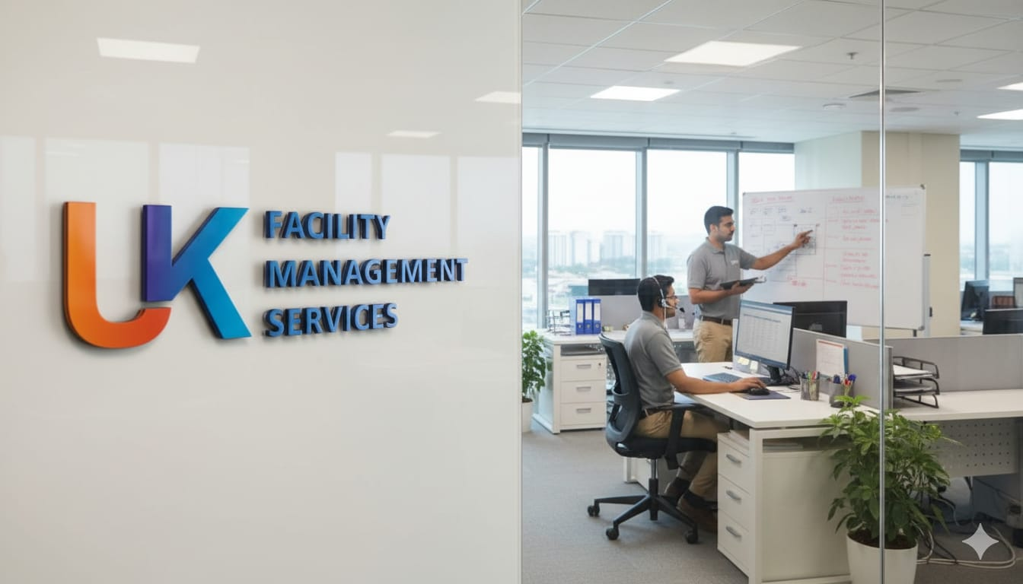

UK Facility Management Services
UK Facility Management Services is a trusted partner in comprehensive facility management and support solutions. We are committed to delivering excellence through reliable, efficient, and high-quality services tailored to client needs. Driven by integrity and professionalism, we ensure clean, safe, and productive environments for every organization we serve. Our operations span multiple industries across India, helping businesses achieve higher standards of efficiency and satisfaction.

Slide 2
Elevating Workplace Standards Through Expert Solutions
Who We Are
Our Purpose
UK Facility Management Services is a professionally managed organisation providing comprehensive facility management and support solutions across diverse industries. We are dedicated to enhancing workplace standards through our expertise, efficiency, and unwavering commitment to integrity and excellence.
At UK Facility Management Services, we don't just maintain spaces—we help businesses build an environment that reflects professionalism, productivity, and pride. Every service we deliver is designed to support your operational goals whilst creating a workplace that your employees and visitors will appreciate.
With a focus on delivering superior quality and operational consistency, we offer a full spectrum of facility services designed to create clean, safe, and productive environments. Our team of well-trained professionals ensures that every service is executed with precision, reliability, and a client-first mindset.
Our approach combines industry best practises with innovative solutions, ensuring that your facility operates at peak efficiency whilst maintaining the highest standards of cleanliness, safety, and presentation.

Slide 3



Comprehensive Service Portfolio
We deliver a complete range of facility management solutions tailored to meet the unique needs of modern businesses. Our services are designed to enhance operational efficiency, maintain exceptional standards, and create environments where people thrive.
Housekeeping & Maintenance
Deep Cleaning & Sanitisation
Office Support Staffing
Systematic and result-oriented housekeeping solutions that uphold hygiene, order, and efficiency across all premises.
Comprehensive cleaning powered by modern equipment and eco-friendly materials promoting health and sustainability.
Deployment of skilled and courteous support personnel ensuring smooth daily operations and professional conduct.

Slide 4
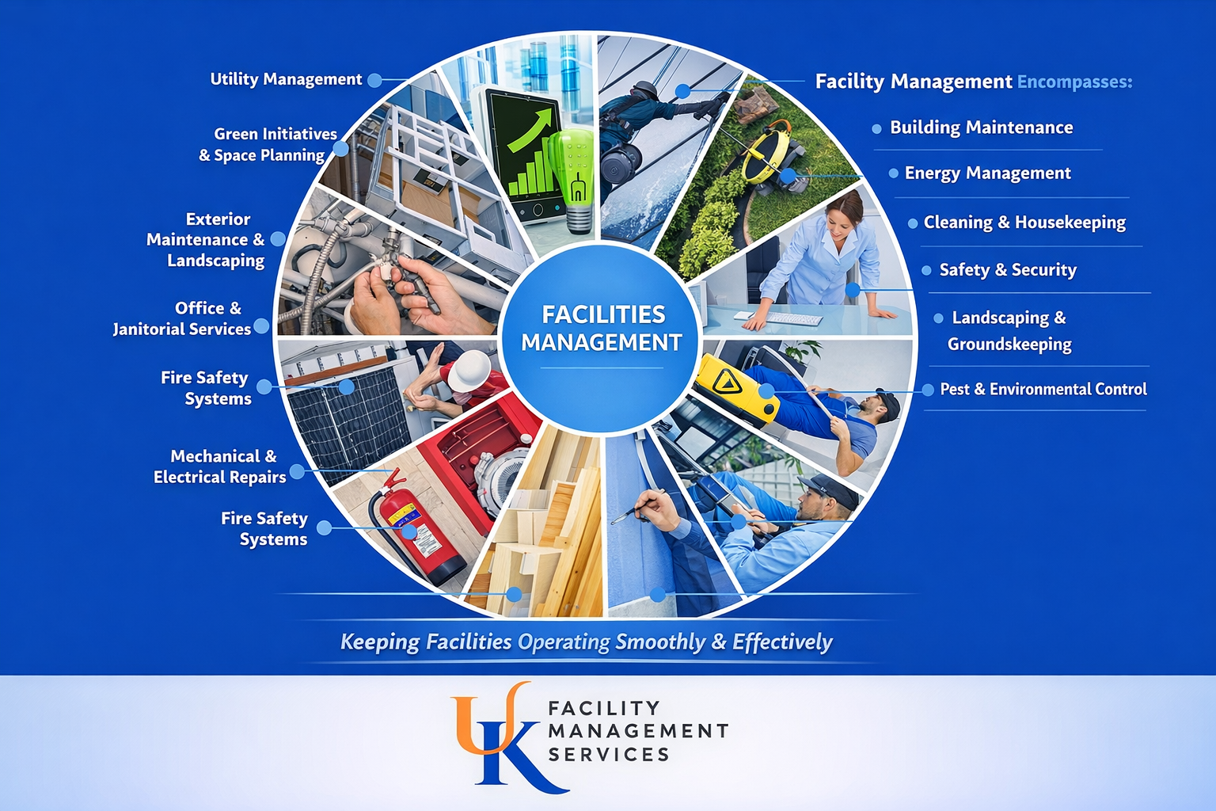
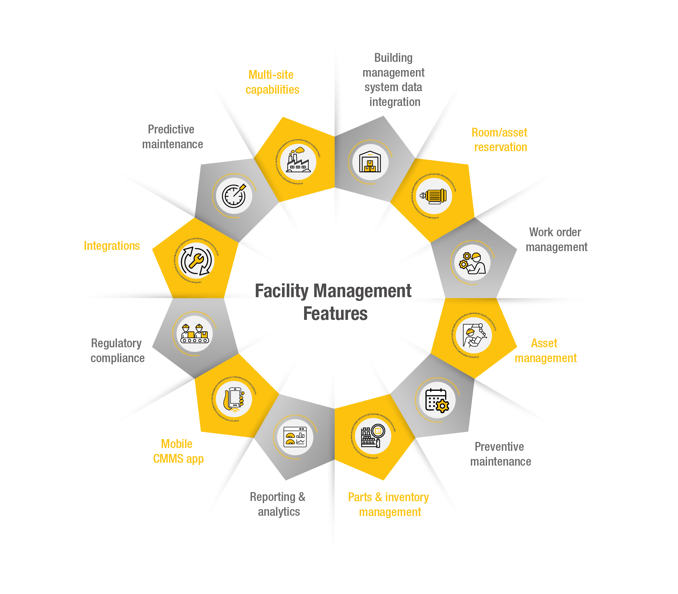



Specialised Solutions for Every Need
Pantry & Hospitality Management
Specialised Cleaning Solutions
Customised Facility Solutions
Efficient management of pantry and hospitality services to ensure comfort, courtesy, and seamless service delivery for both employees and guests. Our trained staff understand the importance of creating welcoming spaces that enhance workplace satisfaction.
Targeted cleaning for workstations, glass panels, restrooms, and high-contact areas using safe, high-performance cleaning agents and standardised methods. We employ the latest techniques to ensure thorough sanitisation whilst minimising disruption to your operations.
Tailor-made facility management programmes designed to align with each client's operational structure, standards, and budget. We work closely with you to develop solutions that deliver optimum efficiency, cost-effectiveness, and satisfaction across all touchpoints.

Slide 5
Industries We Proudly Serve
Our extensive experience spans multiple sectors, each with unique requirements and standards. We understand the specific challenges and expectations of diverse industries, allowing us to deliver targeted solutions that meet and exceed sector-specific benchmarks.
International & Residential Schools
Corporate Offices & Business Parks
IT & BPO Companies
Industrial & Manufacturing Units
Supporting 24/7 operations with flexible, reliable facility management solutions.
Creating safe, hygienic learning environments that support educational excellence and student wellbeing.
Maintaining professional standards that reflect your brand values and support productivity.
Ensuring compliance, safety, and operational efficiency in demanding environments.
Healthcare, Hospitality & Retail
Delivering exceptional cleanliness and service standards where first impressions matter most.

Slide 6
Our Core Values
These six principles guide every decision we make and every service we deliver. They represent our commitment to excellence and our dedication to building lasting partnerships based on trust and mutual respect.
Integrity
We uphold the highest ethical standards in every aspect of our operations, ensuring honesty, transparency, and accountability. Our word is our bond, and we take pride in building relationships founded on trust and ethical conduct.
Quality
We are committed to excellence through continuous improvement and meticulous attention to detail. Every task, regardless of size, receives the same level of care and precision to ensure outstanding results.
Reliability
Our clients trust us for consistent, dependable service delivery, day in and day out. We understand that your operations depend on our performance, and we never take that responsibility lightly.
Teamwork
We believe collaboration drives success and efficiency. Our teams work cohesively, supporting one another and sharing knowledge to deliver seamless service across all touchpoints.
Customer Focus
Our clients' satisfaction is at the centre of everything we do. We listen carefully, respond promptly, and continuously adapt our services to meet evolving needs and expectations.
Innovation
We continuously adapt to new technologies and methods for better outcomes. By staying at the forefront of industry developments, we ensure our clients benefit from the most effective and efficient solutions available.

Slide 7

Our Mission & Vision
Our Mission
Our Vision
To deliver world-class facility management services with integrity, efficiency, and innovation—enhancing workplace performance and building long-term partnerships based on trust and excellence.
To be recognised as a premier facility management company that sets new benchmarks in quality, professionalism, and ethical service delivery across the United Kingdom.
We strive to be more than just a service provider; we aim to be a strategic partner in your success, contributing to your operational efficiency and creating environments where your people can perform at their best.
We envision a future where UK Facility Management Services is synonymous with excellence, where our reputation for integrity and quality makes us the first choice for organisations seeking outstanding facility management solutions.

Slide 8












The UK Facility Management Difference
Trained Professionals
Eco-Friendly Approach
Every team member undergoes comprehensive training and continuous development
Sustainable practises and environmentally responsible cleaning solutions
Responsive Support
Modern Equipment
Dedicated account management and prompt issue resolution
State-of-the-art tools and technology for superior results
Flexible Solutions
Quality Assurance
Customised programmes that adapt to your unique requirements
Rigorous monitoring and regular audits ensure consistent excellence
These distinguishing factors combine to deliver a service experience that goes beyond basic facility management. We create partnerships that drive value, enhance performance, and contribute to your organisational success.

Slide 9
Our Commitment to Integrity
At UK Facility Management Services, integrity is not just a value—it is the foundation of our relationships and reputation.
We ensure that every task, no matter how small, is carried out with transparency, respect, and accountability. Our commitment to operational excellence and ethical service delivery has earned us the confidence of our clients and partners alike.
Transparent Operations
Ethical Conduct
Accountable Service
Clear communication, honest reporting, and open dialogue at every stage of service delivery.
Strict adherence to professional standards and regulatory requirements across all operations.
Taking responsibility for outcomes and continuously improving based on feedback and performance metrics.
This unwavering commitment to integrity ensures that when you partner with UK Facility Management Services, you're working with an organisation that values your trust as much as your business. We build relationships that stand the test of time, founded on mutual respect and shared success.

Slide 10
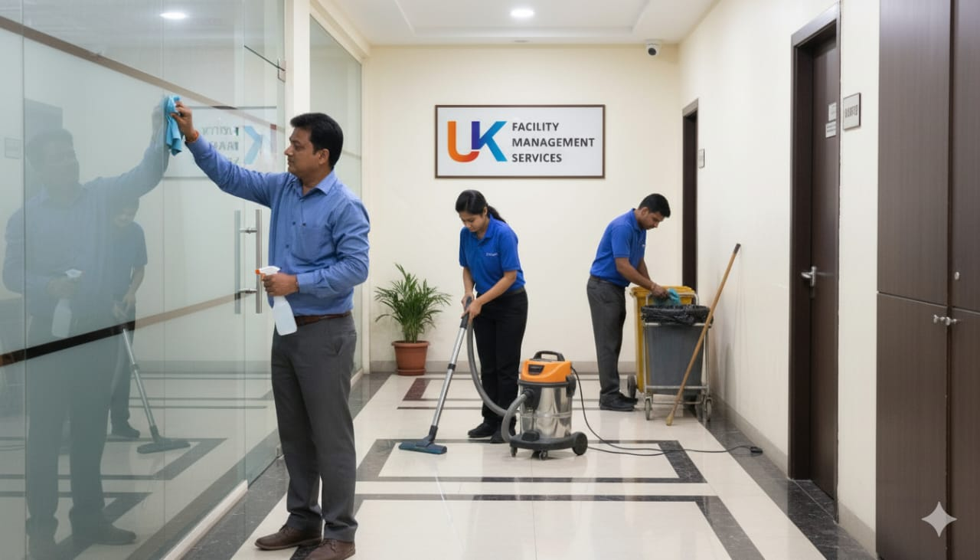


Partner with Excellence
Ready to Elevate Your Facility Standards?
Whether you're managing a corporate office, educational institution, healthcare facility, or industrial unit, UK Facility Management Services has the expertise, resources, and commitment to transform your workplace environment.
Our team of dedicated professionals is ready to understand your unique requirements and develop a customised facility management solution that aligns with your operational goals, budget constraints, and quality expectations.
Why Choose Us?
Proven track record across multiple industries
Comprehensive service portfolio under one roof
Trained, vetted, and professional staff
Flexible, scalable solutions that grow with your needs
Commitment to sustainability and eco-friendly practises
Transparent pricing and reliable service delivery
Dedicated account management and support
Let us help you create a workplace that reflects professionalism, enhances productivity, and instils pride in everyone who enters your facility.
Get in Touch
Contact us today to discuss your facility management needs and discover how we can support your organisation's success through exceptional service delivery.

